Slide 1

Customer Insights
Learnings from Oct-Dec EBC & CEC visits
James Woloszyn, Global Customer Advocacy

Slide 2
Customer Advocacy Insights
Objective
This report provides a monthly view of valuable customer and partner insights from the Executive Briefing Center and Customer Engagement Centers.
Centers in scope
Time period
Data sources
Action items
Customer survey responses:
Which solutions would you like to learn more about?
What would you suggest to our CEO
Additional comments
Post engagement summaries
Briefing Program Manager interviews
Palo Alto
Houston
New York
London
Singapore
Monthly data
Notes: Critical issues that are raised in any briefing are handled through our standard 24 hour escalation mechanisms
Meetings that do not require surveys and post engagement summaries are out of scope.

Slide 3
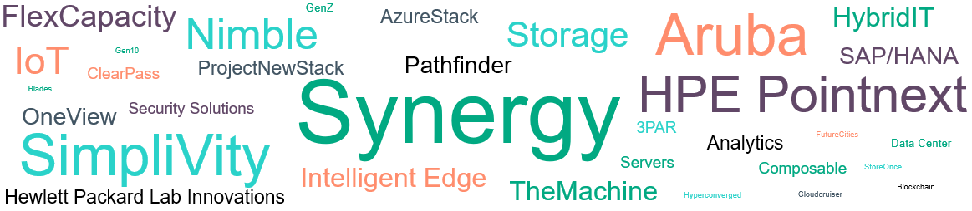
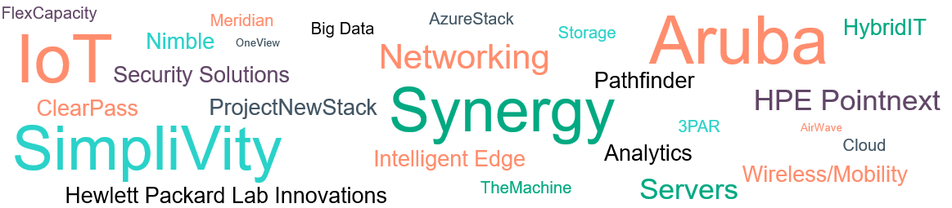
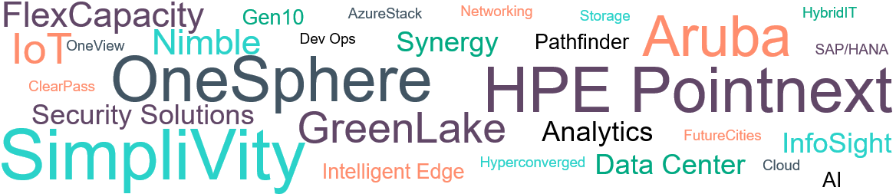
3 month trend Everything aaS and SW defined interest increased post-Discover; reduced Houston briefings post-flood reflected in Synergy trend
Oct
Nov
Dec
Notes:
Everything aaS – HPE Pointnext, Prometheus-Greenlake, Flex Capacity, SAP Hana
Intelligent Edge -
Blades plus – Synergy, SimpliVity, Apollo, Proliant Gen10
Gen10 transition –
Shift to SW defined – OneView, SimpliVity, Synergy, One Sphere
Storage to flash – Nimble, StoreOnce, 3PAR, SimpliVity

Slide 4
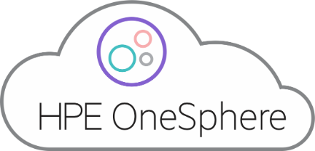


In December, customers wanted to learn more about…
Top three customer interests
SimpliVity
HPE Pointnext
OneSphere
FlexCapacity
Gen10
AzureStack
Networking
HybridIT
Storage
Aruba
IoT
Nimble
Dev Ops
Synergy
Pathfinder
OneView
OneSphere
SAP/HANA
HPE Pointnext
ClearPass
Security Solutions
GreenLake
SimpliVity
Analytics
FutureCities
InfoSight
Intelligent Edge
Hyperconverged
Data Center
Cloud
AI

Slide 5
Top 3 Customer Interests: October-December
SimpliVity
HPE Pointnext
OneSphere
Dec
24%
Dec
Dec
27%
OneSphere
24%
Oct
21%
Oct
18%
Oct
7%
NewStack
0%
0%
WW% of visits expressing interest post briefings
distribution of visits expressing interest post briefing
WW% of visits expressing interest post briefings
distribution of visits expressing interest post briefing
WW% of visits expressing interest post briefings
distribution of visits expressing interest post briefing in OneSphere/NewStack
Observations
"More on why SimpliVity vs. competition. Not speeds and feeds. How do we beat Nutanix. Why should our teams sell SimpliVity vs. Nutanix. I need to gain mindshare with our sellers. Need help to do that. Make it simple. “ – Bradon Harris, Logicalis Director
Partners asking for help positioning SimpliVity vs Synergy
Observations
Customers have increased interest in Everything aaS/GreenLake
Partners want to know how to position HPE Pointnext conversations with customers
Customers with legacy services asking how they bridge from legacy to HPE Pointnext
Observations
Customers are very interested want to know when OneSphere will be available and when can they test
Briefings
December
Regent University
Deloitte
CTC Corporation
Security Service Federal Credit Union
SimpliVity Workshop
Synopsys, Inc.
Hilton Worldwide
Softbank Corp.
Mindef Singapore
LS Global Co.
November
Long View Systems Co.
Elite Generations
Virginia State University
Amer. Dig./Brookfield Zoo
NGA
Deloitte Consulting LLP
MSD Pharma Pte Ltd.
Accenture (UK) LTD
Public Utilities Board
Hudson County School of Technology
San Benefit Co.,Ltd
October
Logicalis
CUNY
Nike
Blue Cross & Blue Shield
Tech Data
Bosch
Fenwick & West LLP
SEATH Partners
Rolls-Royce Holdings
Synnex
Nationwide Mutual
St Electronics PTE.
Pakistan Air Force
Briefings
December
ITOCHU Techno-Solutions Corporations(CTC)
Nestle
Deloitte
Security Service Federal Credit Union
Babcock Marine
Protective Life Insurance Company
Hilton Worldwide Holdings Inc.
Softbank Corp.
MUFG
November
Virginia State University
Samsung Display Co., Ltd.
J R Simplot
Cerner Corporation
Onx/CBTS/Momentum
October
Logicalis
NCS Pte Ltd
Society for WW Interbank Fin. Telco.
TreeHouse Foods Inc.
SEATH customers
Bosch
ALSO AS Norway Partner
Egyptian Ministry of Defense
ALSO A/S Denmark Partner Briefing
Synnex
Occidental Petroleum Corporation
Integral Ad Science, Inc.
Briefings
December
Deloitte
FirstEnergy Corp.
Visa
Kroger
Softbank Corp.
MUFG
Regent University
Royal Mail Group Limited
Synopsys, Inc.
November
Atlas Air Worldwide Holdings, Inc.
SKY PLC*
ITOCHU Techno Solutions Corporation*
Cerner Corporation*
October
Hiscox*
Wells Fargo & Co.*
Mediaset SpA*
Direct Line Insurance Group PLC*
ConocoPhillips*
* = New Stack
Notes:
Tina – follow-up with PA and NY
Look into if OneSphere is launched in OneSphere (Matt Haron may be able to answer)
Janet – seeing requests for SimpliVity separate more and more
Have briefings with Extended time for Greenlake
Customer said in the roundtable that Greenlake was hard to grasp because it was a large topic – need a really good DL – Synnex – look at the summary and follow-up
Seen some negative attitudes because of Legacy DXC relationships – highlevel with hope to dive deeper
Marcy –
A lot of account teams are including OneSphere in the agenda. Haven’t had dedicated sessions on OneSphere – because need
Video of OneSphere is being used in briefings and being well responded to. OneSphere usually touched on during HPE Strategy or HybridIT. DLs aren’t too comfortable getting
- CTP has been coming up a lot under discussions in OneSphere – CTP and OneSphere tied in briefings. CTP generating a lot of interest.
Michelle
OneSphere in the HybridIT topic, compared to OneView. OneSphere enables getting to the right mix. OneSphere enables you to manage the right Mix
Have a Pointnext/CTP discussion on the right next – keeping Hybrid IT simple, GreenLake – what are the solutions we can outsource for you. What are the different levels – models
There’s a little confusion about how Pointnext and Legacy – need to help bridge between legacy services and Pointnext. How do DXC services and Pointnext augment each other – who owns what. What are we paying for now
OneSphere demo would be great; ability to explain the difference between OneSphere and OneView
Consider that need more categories in BMT to focus on CTP, Greenlake, OneSphere …

Slide 6



October - December, Customers were telling us…
IT top of mind
Leading innovation through IT
Creating personalized experiences
Having the needed data security
What we can improve
Continue to address demands for vertical use cases
Streamline and improve customer support
Speak more to solutions to customer/industry problems
Feedback about strategy
Like where the company is headed
Continue to learn about splits in briefings
Want HPE to keep innovating
Notes:
Data analytics – want to know what products and services to make the process more efficient; want partners. Used to know what the customer wanted and now the trends are moving so fast. How to stay up with it.

Slide 7

Most frequent customer requests & recommendations
Briefing Insights
Observations
Oct-Dec Briefings
“How can HPE help in our goal have the best and most advanced technology”
Dubai Police General Headquarters
“It is difficult to recruit twenty-somethings to a work environment that does not permit cellular devices, nor have the technology to support cellular devices.”
NGA
“Experiencing 20%-30% growth every year in terms of active students makes AGILITY and CYBER-SECURITY a priority.
Regent University
Customers want to set the bar for tech innovation in their industry
Customers are creating personalized, mobile experiences, to attract the next generation and for efficiency
Network security is a high priority
Leading Innovation
Wells Fargo & Company
Egyptian Ministry of Defense
Occidental Petroleum Corporation
NGA
Dubai Police General Headquarters
ITOCHU Techno-Solutions Corporation
Hilton Worldwide Holdings Inc.
EPCC
Creating personalized experiences
SKY PLC
LSHTM and Birkbeck Universities
Regent University
Everton Football Club Company
NGA
Babcock Marine
Security
Egyptian Ministry of Defense
ExxonMobil Global Services Company
LSHTM and Birkbeck Universities
Regent University
Babcock Marine
Royal Bank Of Canada
Top of mind
“Share more information relevant to visitor's industry, case studies, Returns on benefits.”
Olivier Campagna, Flowserve Director
“After sales support with new innovative technology may be introduced for stronger business relations.”
Adeel Safi, Pakistan Air Force Squadron Leader
“Speak more the business language, benefits and solving industry problems.”
Amir Arooni, NN Group CIO
Demo/use cases requests were for industry verticals, and GreenLake, SimpliVity, and Edgeline
Customers and partners are suggesting better field support
Leading with HPE Pointnext would help customers learn the best solutions for them
Demos/use cases
CUNY
Delteq, Singapore
Blue Cross & Blue Shield of Alabama
Ahold-Delhaize Belgium
Flowserve
Tech Data
JR East Information Systems Co
Berca Hardayaperkasa
Kroger
Support
Pakistan Air Force
Integral Ad Science, Inc.
Nationwide Mutual Insurance Company
CUNY
Logicalis
Provide solutions
Tenncare
NN Group
KPN
Areas to improve
“Keep preaching the hybrid approach.”
Bill Graff Cerner Corporation CIO
“Multiple HP's is confusing”
Roger Newman, Royal Mail Ltd. Design Manager
“The re-focus on technology is the right decision.”
Tim Crum, PayPal, Inc. Director
Customers like our innovation, hybrid IT approach, products, and focus
Customers continue to learn HPE splits and acquisitions from briefings, even the HPE/HPI split
Like strategy
Logicalis
ExxonMobil Global Services Company
Occidental Petroleum Corporation
J R Simplot
Cerner Corporation
American Digital /USG
Learned strategy
Momentum
Samsung Display Co., Ltd.
Tech Data
Logicalis
Royal Mail Ltd.
Appreciate Innovation
China Mobile
Samsung Display Co., Ltd.
PayPal, Inc.
Feedback on strategy
Notes:
Other top of minds:
Optimization - Mediaset SpA, Integral Ad Science, Inc, Deloitte
Plug and Play (want someone else to do the work) - Egyptian Ministry of Defense, ExxonMobil Global Services Company, Royal Bank Of Canada
Cost - Wells Fargo & Company, Integral Ad Science, Inc.

Slide 8
Additional quotes
Collaborate
Recommendations
“Kroger is looking for a partnership not vendor relationship.”
Kroger
“Engage in trial product launches with academia and academic HPC”
Texas A & M University
Interested in develop joint narrative / solution incubation working across R&D teams. Also interested in OEM relationship for Flowserve Pumps with bundling of Edgeline predictive maintenance
Flowserve
NCS Transportation team interested in listing NCS Digital as a Strategic Partner to HPE
NCS Pte Ltd
“Remove hurdles when our company is experiencing issues with HPE tech. ”
Matt Kohler, Protective Life Insurance Company CTO
“Improve your relationship with VMware to prevent competitors from making them more proprietary. VMware needs to stay vendor agnostic.”
Ron Taylor, Nationwide Mutual Insurance Company Technology Consultant

Slide 9
Industry insights (Oct - Dec)
Briefing volume by Industry
Top interests
Synergy – 31%
Aruba – 23%
FlexCapacity – 23%
OneSphere – 23%
SimpliVity – 19%
HPE Pointnext – 19%
Financial Services
Briefings by center
Top interests
Aruba – 30%
Synergy – 30%
HPE Pointnext – 26%
SimpliVity– 22%
Manufacturing
Briefings by center
Public Sector
Briefings by center
Top interests
SimpliVity – 33%
Storage – 29%
IoT – 19%
Synergy – 19%
Communications, Media & Entertainment
Briefings by center
Top interests
SimpliVity – 19%
IoT – 19%
Aruba – 19%
OneSphere – 19%
HPE Pointnext – 19%
Storage – 19%
Top interests
Pathfinder – 33%
IoT– 22%
Synergy – 22%
SimpliVity – 22%
The Machine – 22%
Health &
Life Sciences
Briefings by center

Slide 10
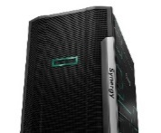

Partner Insights (Oct - Dec)
Insights from Channel/Reseller and System Integrator engagements
Top Partner Interests
Partner recommendations
“Pointnext could work better with and through partners rather than direct to customer.”
Jonathan Melia, Computacenter manager
“Supply Chain and Support issues need to get resolved.”
John Czapko, Logicalis Director
“Believe that by continuing to offer customers access to the EBC will continue to enable HPE a stronger and strategic partner.”
Mike Owens, Brookfield Zoo VP from American Digital/Brookfield Zoo briefing
“Provide more sales enablement tools...thought leading content in specific verticals and marketing materials for sales to engage customers.”
Ed Little , Momentum Sales manager
“Consider better alignment with the reseller who hosted the visit. For example, it appeared that HPE was suggesting reduction to one data center and backing up to the cloud, whereas our reseller would lose business if we did that”
Mark Lisinski, TreeHouse Foods, Inc Director
Synergy
SimpliVity
IoT/Aruba
Nimble
31%
42%
21%
18%
Partner engagement volume by Center
Notes:
“Improved support options - contract support for C7000. We are really struggling in this area.”
Steve Tippet, Nationwide Mutual Insurance Company Technology Consultant
“Any future training on HPE Synergy wouuld be great“ – Wipro Limited
"Consider better alignment with the reseller who hosted the visit. Some topics recommended actions inconsistent with our resellers offerings. For example, it appeared that HPE was suggesting reduction to one data center and backing up to the cloud, whereas our reseller would lose business if we did that.“ – TreeHouse Foods, Inc
“This is our second time here and next month we are bringing our customers here. It shows you our commitment to HPE.”
Sudianto Oei, CEO, Hypernet
“What is our channel GTM? Joint selling vs. delivery only. How do we not directly compete?”
Presidio Inc

Slide 11
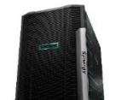

Breakdown by center (July – December )
 | Top 5 interests |  |  |  |  | Top 3 Industries & Associated Interests
Palo Alto | Synergy |  |  |  | IoT | Manufacturing Synergy IoT SimpliVity, Aruba | Financial Services Synergy Aruba Pathfinder, OneSphere | Public Sector Hewlett Packard Labs, HPE Pointnext, The Machine OneView, Analytics
Houston |  | Synergy | One View |  | IoT | Manufacturing SimpliVity OneView, IoT, Nimble, Intelligent Edge, 3PAR | Public Sector Synergy Airwave | Energy Aruba, IoT
New York |  | Synergy | Flex Capacity |  | Storage | Financial Services Flex Capacity OneSphere, HPE Pointnext, GreenLake | Health & Life Science - HPE Pointnext, Cloud , 3PAR | Communications, Media & Entertainment HPE Pointnext
London | Synergy |  |  | IoT |  | Financial Services Synergy OneSphere | Public Sector ClearPass, Wireless Mobility Aruba, Nimble | RCG Synergy, Hybrid IT
Singapore |  | Synergy | IoT |  | Hybrid IT | Public Sector Aruba, SimpliVity Synergy Analytics | Financial Services Synergy Servers | Manufacturing SimpliVity HPE Pointnext, IoT, Intelligent Edge Aruba, Hybrid IT

Slide 12
Thank you

Slide 13
In November, customers wanted to learn more about…
Top three customer interests
FlexCapacity
Meridian
AzureStack
Aruba
HybridIT
IoT
Nimble
Big Data
Storage
OneView
Networking
Security Solutions
Pathfinder
Synergy
HPE Pointnext
ClearPass
ProjectNewStack
SimpliVity
3PAR
AirWave
Intelligent Edge
Analytics
Cloud
Servers
Wireless/Mobility
Hewlett Packard Lab Innovations
TheMachine

Slide 14
In October, customers wanted to learn more about…
Top three customer interests
FlexCapacity
Nimble
GenZ
AzureStack
Aruba
HybridIT
Storage
IoT
Gen10
Pathfinder
SAP/HANA
ClearPass
ProjectNewStack
Synergy
HPE Pointnext
Blades
OneView
Security Solutions
SimpliVity
3PAR
FutureCities
Analytics
Data Center
Intelligent Edge
Servers
Composable
StoreOnce
Hewlett Packard Lab Innovations
TheMachine
Blockchain
Hyperconverged
Cloudcruiser

